Slide 1
Content for eportfolio
13 February 2018

Slide 2


Outline
CONTENT
Visual content (incl. screencast)
Text – drafting, an ongoing process
Other media ie. files
Attention to ethical issues: privacy, data protection, copyright
RATIONALE
Evidence of work
Opportunity to show creativity
Adds richness to eportfolio
See rubric on Moodle

Slide 3
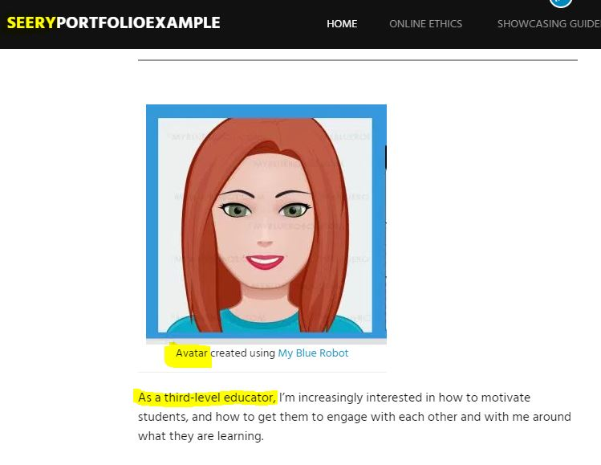

Image of YOU!
Photo – you only
Your photo can build in its own privacy
Remove location, GPS data
Avatar
My Blue Robot.
Avachara

Slide 4
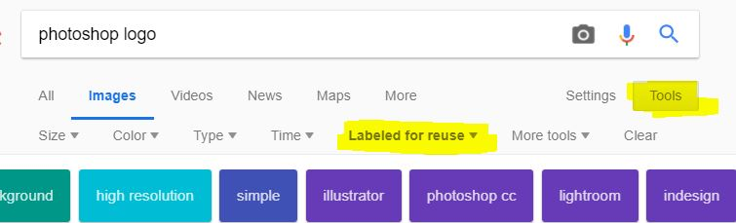
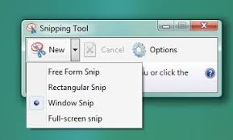

Images & copyright
SELECT
CREATE
Start by carefully selecting images / material
Image captions should attribute (& link back to) the original source
See Mairead’s WordPress for links
CREATE
Even better, create your own images

Slide 5


Screencast – 3 stages
I Pre-recording
Plan – map – loose script
Map. Visual (=action on screen) and audio (=what you will say)
Welcome and Outline – orientation for listeners
Short sentences. Practise once or twice before recording.
Raise your voice. Use intonation.
Speak slowly. Pauses are fine.
Good ending, wrap-up & thanks.

Slide 6
Screencast – stages 2 & 3. Tools.
Recording
Tools
Quiet location
Limit distractions
1 min
Record with standard dimensions (e.g. 480p, 720p)
Post-recording
Upload to YouTube or other host
Screencast-o-matic
Active Presenter
Ice Scream Recorder
Ellis, C. (2018, January 2). The best free screen recorder 2018. Retrieved from www.techradar.com: http://www.techradar.com/news/the-best-free-screen-recorder

Slide 7

Creative Commons
You can share and adapt…
…you MUST attribute…
… and only for non-commercial purposes.
Visit: https://creativecommons.org/licenses/

